Slide 1
AB testing
Roll number:- CB.EN.U4CSE20256
Name:- Sarath Krishna C K
Application:- amazon
Dataset:-based on sales of games in amazon

Slide 2
The aim is to see whether year(the game was released) is associated with GLOBAL SALES.
null hypothesis(H0):Avg sales of stratergy and action games are equal.
Alternate hypothesis(H1):Avg sales of strategy games is less than action games.

Slide 3
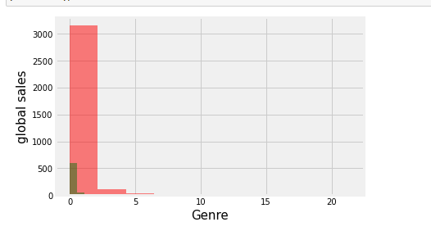
The plot shows us that the global sales of games belonging to the genre of "action" has more sales than compared to stratergy type games This shows us that global sales of games are depended upon its Genre

Slide 4
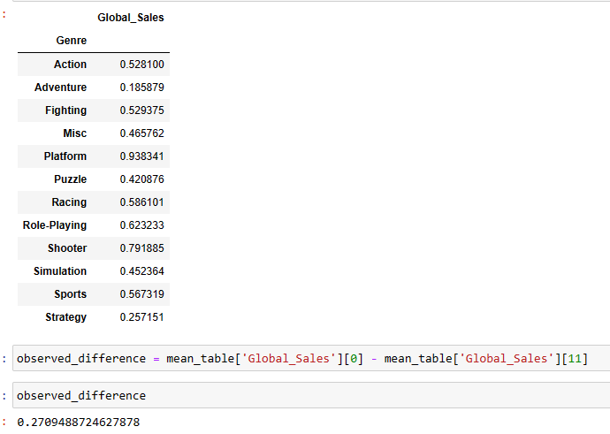

Slide 5
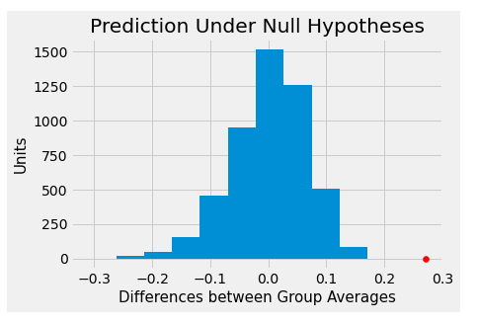
the plot shows us that the global sales of games belonging to the genre of "action" has more sales than compared to stratergy type games This shows us that global sales of games are depended upon its Genre

Slide 6
The observed difference in the original sample is about 0.2709488724627878. The observed value of the statistic and the predicted behavior of the statistic are plotted.
The conclusion of the test is that the data support the alternative more than they support the null. The average Global_sales of Strategy games is less than the average global sales of Action games.

Slide 7
The empirical P-value is 0.0, meaning that none of the 5,000 observed samples resulted in a difference of 0.2709488724627878. the average sales of stratergy games is less than action games. the low P-value favours the alternative hypothesis. hence reject the null hypothesis.
Avg sales of strategy games is less than action games.

